Slide 1
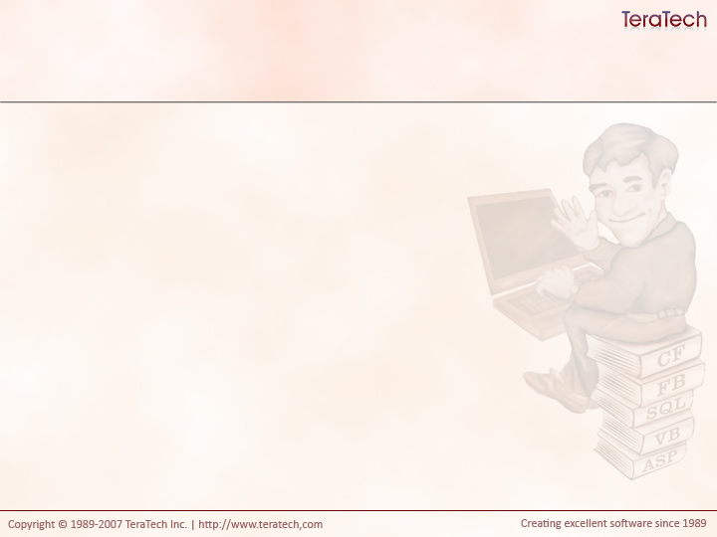
Model-Glue In-Depth
The Nitty-Gritty of Model-Glue

Slide 2
What We’re Going To Learn
Configuring the Framework
Default Events
View Values
Exit Actions (XFAs)
Message Arguments
Performance Tips

Slide 3
Configuring the Framework
Configured via ColdSpring.xml
Located under /Config by default
Can configure more than just Model-Glue
Notes:
Open a coldspring.xml file and review

Slide 4
Configuration Highlights
debug – true or false
  Indicates if the debug output should be shown.
defaultEvent – string value
  Sets the name of the default event.
  Used when no event argument provided.
viewMappings – relative path to view folder
  This is where Model-Glue will look for included views.
  Comma separated list
  Searched in order
configurationPath – relative path to ModelGlue.xml
defaultExceptionHandler – string value
  An event to fire when errors are thrown

Slide 5
Reloading (or not) The Framework
By default the framework reloads on each request.
  Bad for production, good for development
reload – true or false
  Indicates if the framework and configuration should be reloaded on each request.
  Set to false for production!
reloadKey – string value
  The name of a url variable that is used to reload the framework.
  Defaults to “init”
reloadPassword – string value
  The value that must be provided to the reload key variable.
  Defaults to “true”
http://localhost/index.cfm?reload=true

Slide 6
Default Events
A set of predefined messages broadcast on every request
onRequestStart
  Fired before any event handlers execute
  If multiple listeners, order of execution is not guaranteed
onQueueComplete
  Fired before views are processed, after all messages have been broadcast
onRequestEnd
  Fired after all broadcasts and views have been processed, before HTML is returned to client.

Slide 7
I am #viewstate.getValue(“myself”)#
Myself value holds the default file name and the event value
  The default file can be can be changed using the defaultTemplate configuration argument.
  Example: index.cfm?event=
Can be used in links or form actions…
<a href="#viewstate.getValue("myself")#Foo">Example</a>
Would result in…
<a href index.cfm?event=Foo">Example</a>

Slide 8
View Values
Uses <value> tags in a <view> tag.
Sets value in the ViewState

Slide 9
Exit Events
Uses <value> tags in a <view> tag.
A common technique in Fusebox (XFAs)
Provide values to views for event names
A good technique to deal with changing event names overtime
Useful in changing the flow of an application
Allows configuration to show a complete map of the application.
  “Event X has links to A, B and C.”

Slide 10
Exit Event Example
ModelGlue.xml
  <include name="body" template="dspMyView.cfm">
    <value name="xe.home" value="page.index" />
  </include>
dspMyView.cfm
  <cfset myself = viewstate.getValue("myself")/>
  <cfset xe.home = viewstate.getValue("xe.home")/>
  <cfoutput>
  <a href="#myself##xe.home#">Home</a>
  </cfoutput>
Results in….
  <a href="index.cfm?event=page.index">Home</a>

Slide 11
Message Arguments
Uses <argument> tags in <message> tag.
Additional data that is passed along with messages
Useful for defaulting values
Useful for passing data into generic events
Especially powerful when coding to component interfaces
  Generic List, Read, Delete, Save

Slide 12
Message Arguments
ModelGlue.xml
  <message name="NeedFortune" />
  <argument name="defaultCategoryId" value="1" />
  </message>
Controller
  <cffunction name="DoGetFortune" access="public" returnType="void" output="false">
  <cfargument name="event" type="any">
  <cfset var defaultCategoryId = arguments.event.getArgument("defaultCategoryId") />
  <cfset var categoryId =
  arguments.event.getValue("categoryId", defaultCategoryId) />
  <cfset arguments.event.setValue("fortune", variables.Fortune.getFortune(categoryId)) />
  </cffunction>

Slide 13
Performance Tips
Set reload to false
  Even when developing, if you want
Disable ColdFusion debugging
  In particular, don’t enable Report Execution Times.
Enable trusted cache
  In production only

Slide 14
Exercise Time!
Use a new message to log fortunes into the session scope.
Create a new page to display the recent fortunes.
  Use an event argument to control the number to show.
Update all views to use “myself” and Exit Events
Put the application into a production-ready model

Slide 15
Discuss

